Slide 1

ADIKAVI NANNAYa UNIVERSITY UNIVERSITY COLLEGE OF ENGINEERING RAJAMAHENDRAVARAM
MACHINE LEARNING USING PYTHON
Water Quality Prediction Using Machine Learning
GUIDANCE BY
Mrs. Jayanthi Harini
Assistant Professor
Department of computer science and engineering
University College of Engineering
PRESENTATION BY
P.Sushma
208297601042

Slide 2
Contents
ABSTRACT
INTRODUCTION
MACHINE LEARNING
PYTHON
PROPOSED APPROACH STEPS
SYSTEM ARCHITECTURE
STAGES IN MACHINE LEARNING
DESIGN METHODOLOGY
RESULTS
CONCLUSION

Slide 3
ABSTRACT
One of the key functions of global water resource management authorities is river water quality (WQ) assessment. A water quality index (WQI) is developed for water assessments considering numerous quality-related variables. This can be tackled through the latest machine learning (ML) techniques renowned for superior accuracy. In this study, water samples were taken from the wells in the study to develop WQI prediction models. Water quality prediction involve classification techniques to predict the water potability. Classification is the most used technique that is being used for the prediction of potability of water which involve Logistic Regression and Support vector classifier techniques in this project. Different performance criteria are being employed in order to boost the performance of already existing ways.

Slide 4
INTRODUCTION
Water pollution is one of the critical challenges of the modern world. The global water crisis is the serious threat the human race faces these days. Water quality is need to be checked in certain regions whether the water is suitable for drinking or not i.e. water potability. Water quality is predicted by analyzing the soluble contents in the water. Classification techniques are used to predict the water quality A supervised machine learning predictive algorithm is consumed with the predefined collection of training data. The algorithm then gains expertise from the training dataset and produces rules for predicting the class label for a new data set.

Slide 5
MACHINE LEARNING
Machine Learning is a system that can learn from example through self-improvement and without being explicitly coded by programmer. The breakthrough comes with the idea that a machine can singularly learn from the data (i.e., example) to produce accurate results. Machine learning combines data with statistical tools to predict an output. This output is then used by corporate to makes actionable insights.
Machine learning is also used for a variety of task like fraud detection, predictive maintenance, portfolio optimization, automatize task and so on.
Machine learning is the brain where all the learning takes place. The way the machine learns is similar to the human being. Humans learn from experience.

Slide 6
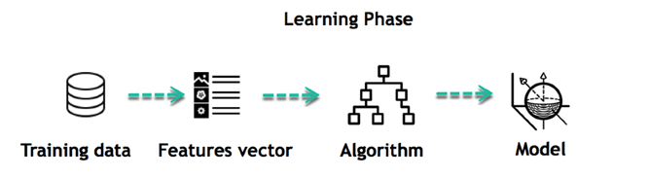
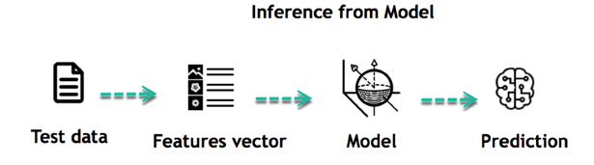
The core objective of machine learning is the learning and inference.
Learning:
Inference:

Slide 7
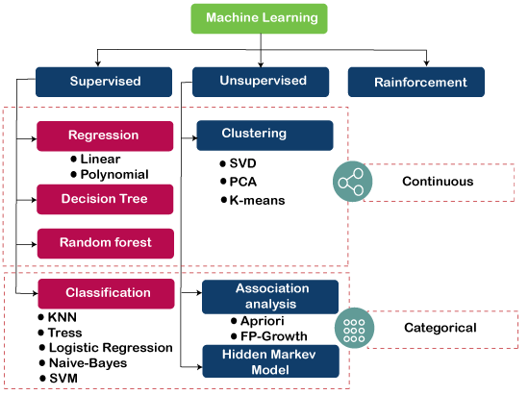
Algorithms in Machine Learning:

Slide 8
PYTHON
Python is a high-level, interpreted, interactive and object-oriented scripting language. Python is designed to be highly readable. It uses English keywords frequently where as other languages use punctuation, and it has fewer syntactical constructions than other languages.
Python was developed by Guido van Rossum in the late eighties and early nineties at the National Research Institute for Mathematics and Computer Science in the Netherlands.

Slide 9
Libraries that are used in this project:
1. Numpy : numerical calculations, array creations
2. Pandas : read the data (in any format excel ,csv,Json )
3. Matplotlib : graphical representation in 2D
legend()
plt show()
4. Seaborn : data visualisation in 3D
5. Sklearn : implementation
a. we import the sci-kit
b. label encoder

Slide 10
PROPOSED APPROACH STEPS
First, we take software dataset.
Filter dataset according to requirements and create a new dataset which has attribute according to analysis to be done
Perform Pre-Processing on the dataset
Split the data into training and testing
Train the model with training data then analyse testing dataset over classification algorithm
Finally you will get results as accuracy metrics

Slide 11
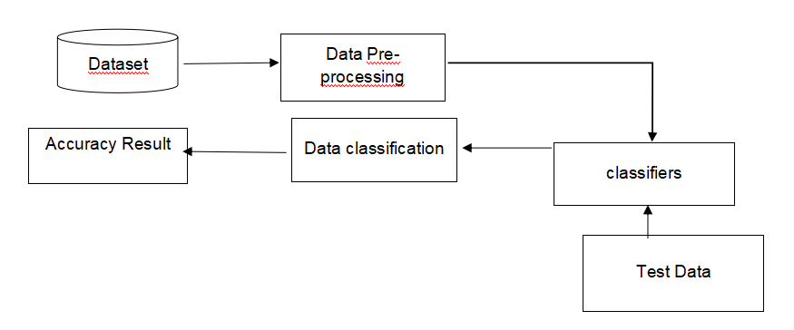
SYSTEM ARCHITECTURE

Slide 12
STAGES IN MACHINE LEARNING
DATA COLLECTION
DATA PRE-PROCESSING
FEATURE EXTRACTION
EVALUATION MODEL

Slide 13
DATA COLLECTION
Data used in this paper is a software data of JM1. This step is concerned with selecting the subset of all available data that you will be working with. ML problems start with data preferably, lots of data (examples or observations) for which you already know the target answer. Data for which you already know the target answer is called labeled data.

Slide 14
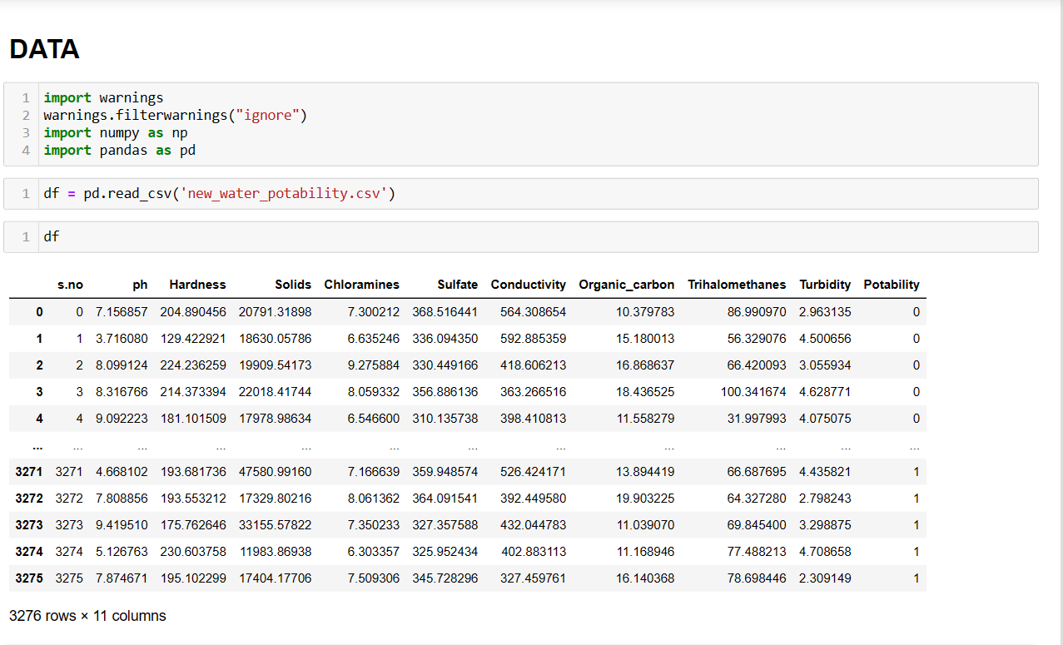

Slide 15
DATA PRE-PROCESSING
Three common data pre-processing steps are:
1. Formatting: The data you have selected may not be in a format that is suitable for you to work with, or the data may be in a proprietary file format and you would like it in a relational database or a text file.
2. Cleaning: Cleaning data is the removal or fixing of missing data. Additionally, there may be sensitive information in some of the attributes and these attributes may need to be anonymaized or removed from the data entirely.
3. Sampling: There may be far more selected data available than you need to work with. You can take a smaller representative sample of the selected data that may be much faster for exploring and prototyping solutions before considering the whole dataset.

Slide 16
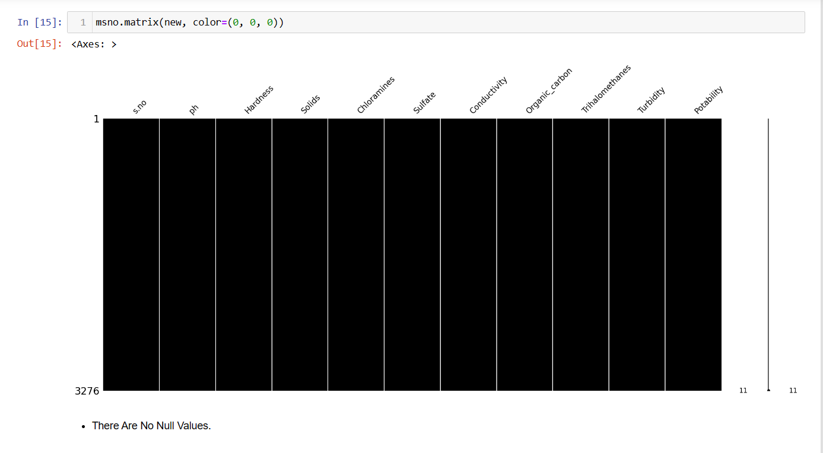

Slide 17
FEATURE EXTRACTION
Feature extraction is an attribute reduction process. Unlike feature selection, which ranks the existing attributes according to their predictive significance, feature extraction actually transforms the attributes. Finally, our models are trained using Classifier algorithm. We use classify module on Natural Language Toolkit library on Python. We use the labeled dataset gathered. The rest of our labeled data will be used to evaluate the models. Some machine learning algorithms were used to classify pre-processed data. The chosen classifiers were Support vector classifier. These algorithms are very popular in text classification tasks.

Slide 18
EVALUATION MODEL
Model Evaluation is an integral part of the model development process. It helps to find the best model that represents our data and how well the chosen model will work in the future. Evaluating model performance with the data used for training is not acceptable in data science because it can easily generate overoptimistic and over fitted models.
Accuracy is defined as the percentage of correct predictions for the test data.

Slide 19
DESIGN METHODOLOGY
Proposed model of this project:
1. Logistic Regression
2. Support Vector Classifier
Support Vector Machine :
Support Vector Machine (SVM) is a supervised machine learning algorithm which can be used for both classification or regression challenges . It is generally utilized in characterization issues. In the SVM calculation, we plot every datum thing as a point in n-dimensional space (where n is number of highlights you have) with the estimation of each element being the estimation of a specific arrange.

Slide 20

At that point, we perform order by finding the hyper-plane that separates the two classes quite well. Bolster Vectors are essentially the co-ordinates of individual perception. The SVM classifier is a wilderness which best isolates the two classes (hyper-plane/line)
The main objective of SVM is to find a hyper plane that best separates the data points into different classes while maximizing the margin between the classes.

Slide 21
Support Vector Classifier :
Support Vector Classifier (SVC) is a type of supervised machine learning algorithm used for classification tasks. It belongs to a broader class of algorithms known as Support Vector Machines (SVM).
Logistic Regression:
Logistic regression is one of the most popular Machine Learning algorithms, which comes under the Supervised Learning technique. It is used for predicting the categorical dependent variable using a given set of independent variables.
Logistic regression predicts the output of a categorical dependent variable. Therefore the outcome must be a categorical or discrete value. It can be either Yes or No, 0 or 1, true or False, etc. but instead of giving the exact value as 0 and 1, it gives the probabilistic values which lie between 0 and 1.
Logistic Regression is much similar to the Linear Regression except that how they are used. Linear Regression is used for solving Regression problems, whereas Logistic regression is used for solving both the classification and regression problems.

Slide 22
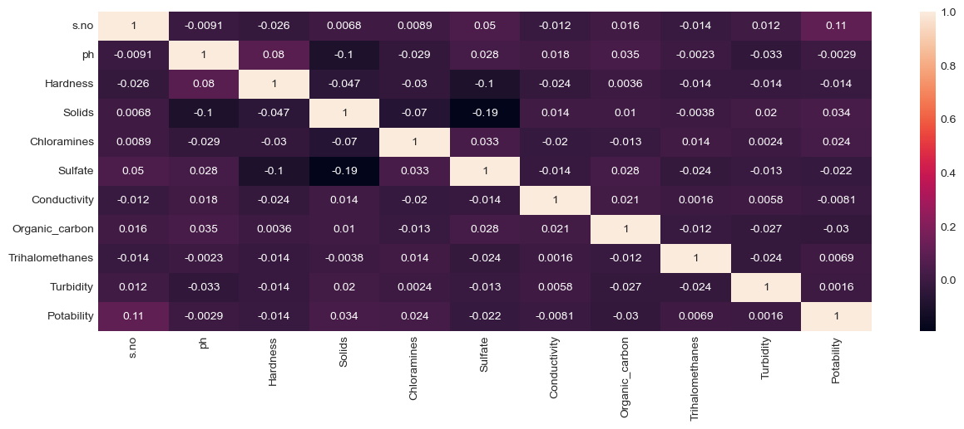
RESULTS
Correlation:
Heatmap

Slide 23
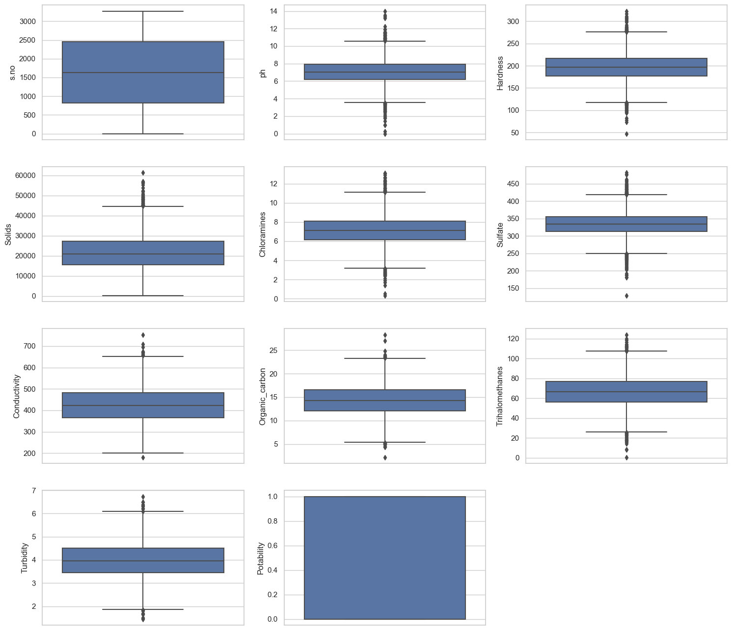
Outliers:

Slide 24
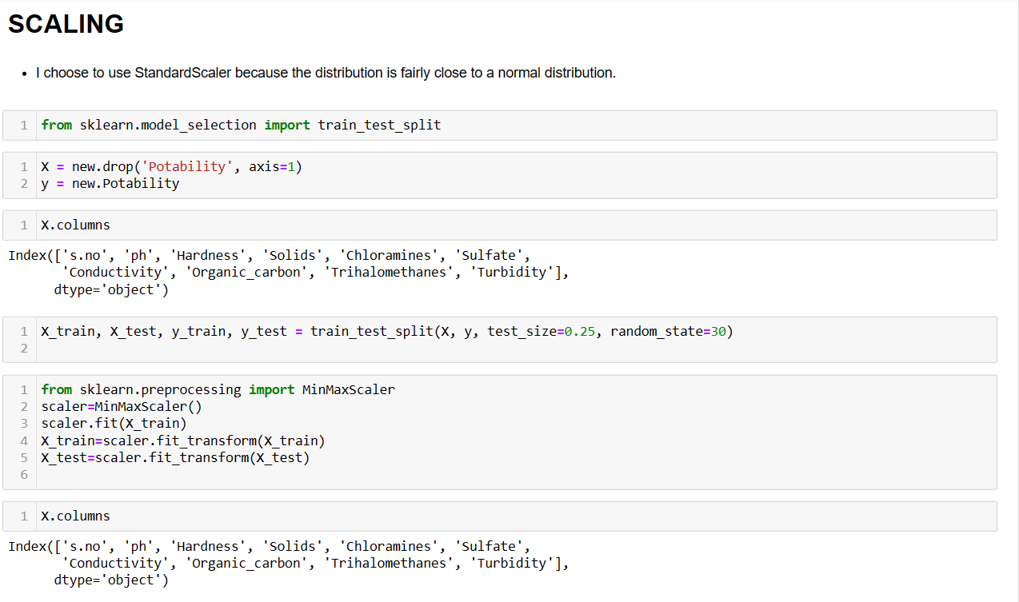
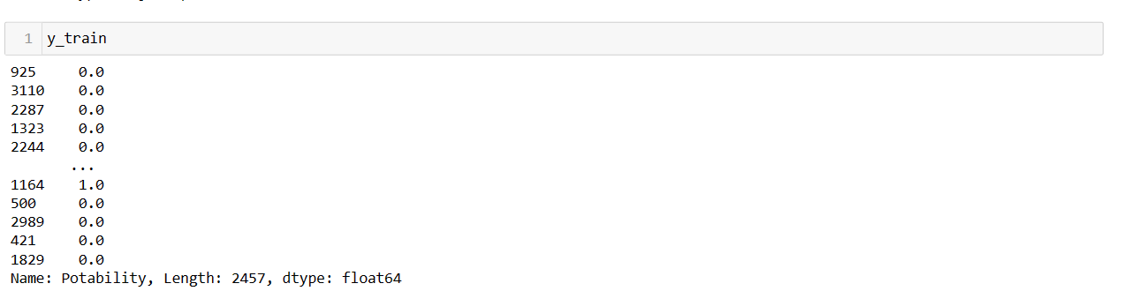
Scaling:

Slide 25
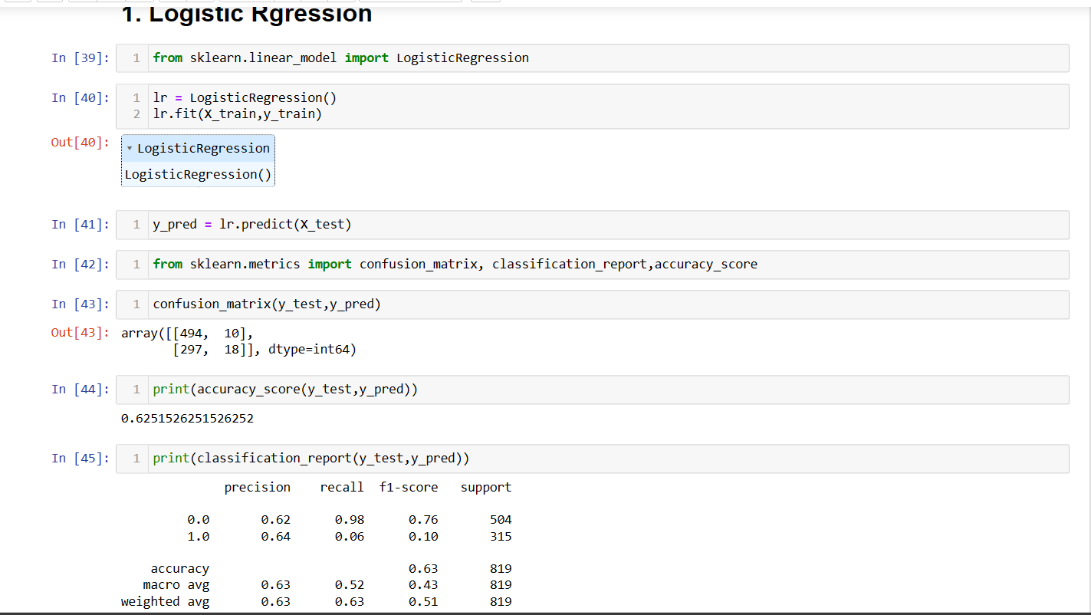
Logistic Regression

Slide 26
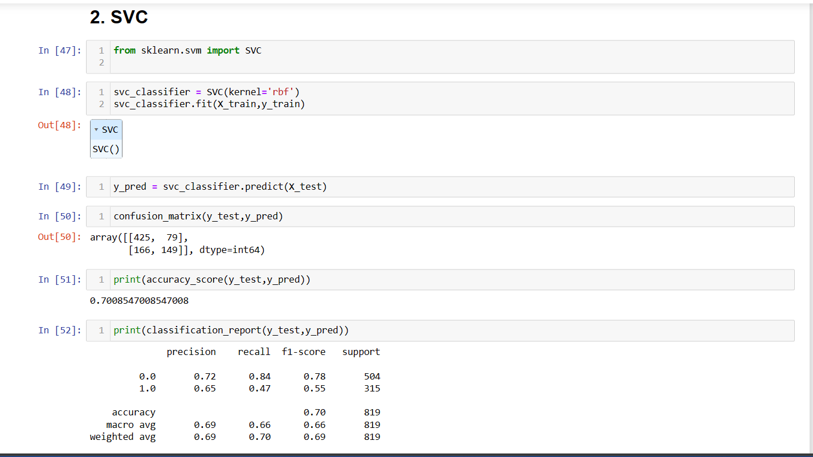
Accuracy based on Support Vector Classifier

Slide 27
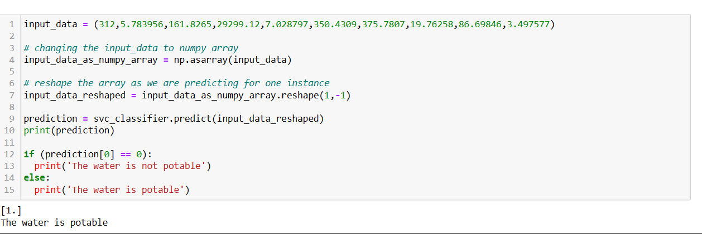
Predicting the output:

Slide 28
CONCLUSION
This research primarily seeks to use information-mining techniques to predict water quality. Moreover, this domain is now a significant research field whereby numerous strategies have been explored to somehow enhance the efficiency of predicting the water quality and its potability. Throughout this study, by designing a new hybrid model using classification, dealt with the issue of classification accuracy for massive datasets.
These findings can be more improved with the use of several datasets. An increase in the number of datasets can enhance the findings. It is also possible to compare further techniques.

Slide 29
THANK YOU

